Slide 1
Launching Personal Narrative Session 3
Writers record memories from their past with as much detail as possible to use as the basis of their writing.
Writers write about stories that matter, but sometimes, they don’t even know why a story is important until they write about it!

Slide 2
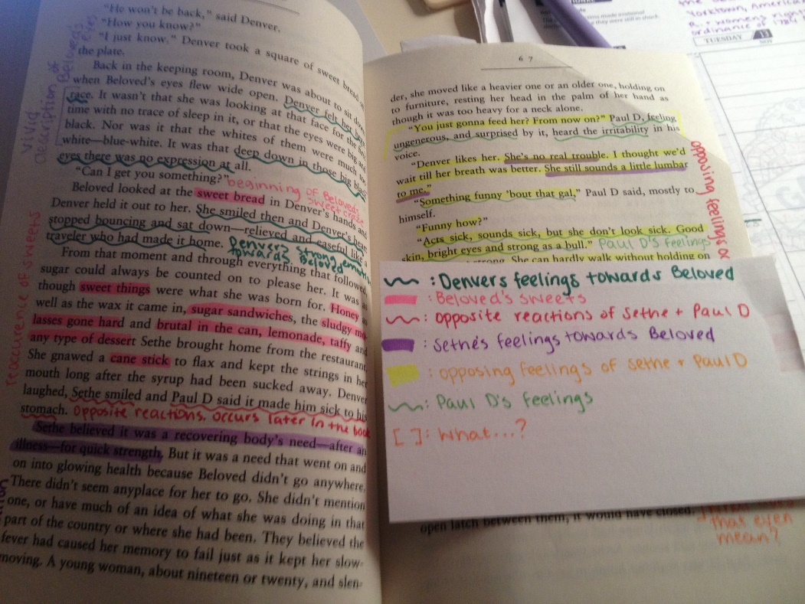
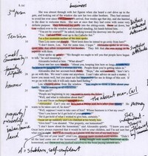
Launching Personal Narrative Session 3
Read our Mentor Texts and look for how the writer finds significance(importance) in events or moments from their life.
Annotate the text!

Slide 3
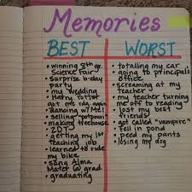
Launching Personal Narrative Session 3
Now it’s your turn!
Write about a significant (important) memory from your life.
Use these sentence starters to start you off. Of course, you can change it up for your own needs!
I thought it was going to be a great day, but boy was I in for a surprise.
That day started off like any other, but it sure didn’t stay that way.
The time that really changed my life was…
The way I view the world was changed forever when…
It should have been a great summer, but…
I used to think______, but now I think_________.
It is the DETAILS that go with the memory that is important.
Start a new draft! Focus on the DETAILS!

