Slide 1

Quick Write #1
Write for 5 minutes (at least 1 paragraph) on this topic in your Writer’s Notebook Zoos
Thoughts? Feelings? Opinions?
Connecting Evidence to Claim
Day 1
Connecting Evidence to a Claim was developed by Jean Wolph.

Slide 2
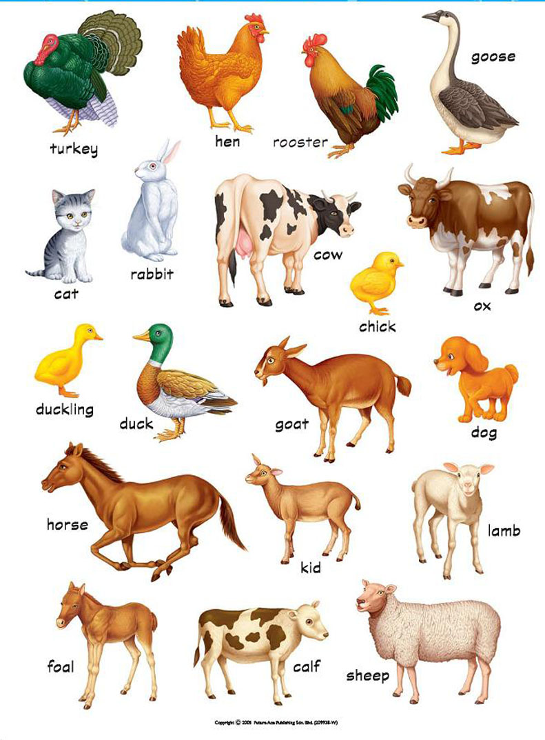
Connecting Evidence to Claim
Day 1
Quick Write #2
Write for 5 minutes (at least 1 paragraph) on this topic in your Writer’s Notebook:
DOMESTICATED ANIMALS
Definition: any of various animals (such as the horse or sheep) domesticated so as to live and breed in a tame condition
Connecting Evidence to a Claim was developed by Jean Wolph.

Slide 3
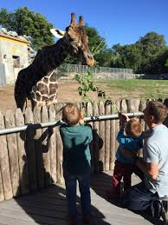
Connecting Evidence to Claim
Day 1
In your Writer’s Notebook, Take notes on video, what’s most important?
https://www.youtube.com/watch?v=RHBuAOp5upU
Quick Write #3 – In your Writer’s Notebook write for 5 minutes about your reaction to the video. Thoughts? Feelings? Opinions?
Turn & Talk

Slide 4
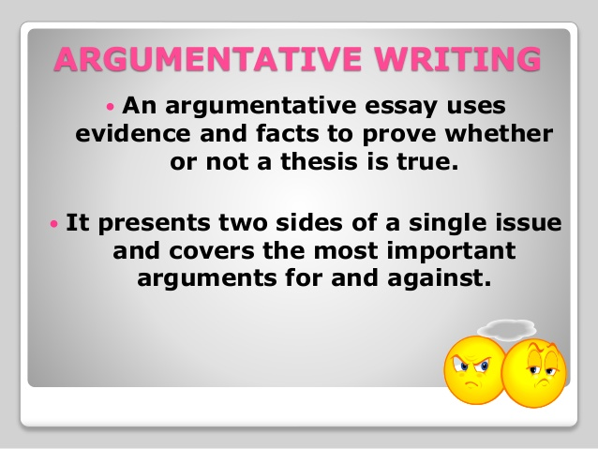
  Illustrating | Using specific examples from the text to support the claim
  Authorizing | Referring to an “expert” to support the claim
  Countering | “Pushing back” against the text in some way (e.g., disagree with it, challenge something it says, or interpret it differently)
Connecting Evidence to Claim
Day 1
In this mini-unit, we’ll practice ways that writers use sources to develop their arguments:
Connecting Evidence to a Claim was developed by Jean Wolph.
Notes:
This is an overview of the types of evidence that will be discussed in this unit.

Slide 5

Connecting Evidence to Claim
Day 1
Read, annotate, & discuss the text set.
Draft a claim related to this issue that you would like to defend.
Identify quotations, facts, and statistics in these articles that will help you support that claim.
Connecting Evidence to a Claim was developed by Jean Wolph.
Notes:
Days 1-4
This mini-unit would be taught AFTER students have had some practice in drafting claims and identifying appropriate evidence to support a claim. These tasks would therefore be done fairly quickly—perhaps in 2-3 class periods, especially if students are able to complete some of the work at home. Strategies learned in other mini-units should be used to annotate the texts and identify potential evidence. Mini-units which might proceed this one include Reality TV and Nutrition & Schools.
This mini-unit could also be inserted WHILE you are teaching a different mini-unit. Start with Slide 4 after students have read and annotated texts for potential evidence to support a claim.

Slide 6
Read: “Should Animals Be Kept In Zoos?”
Connecting Evidence to Claim
Day 2
Close Reading
As you read the texts, look for
Key words. Circle these important words.
Claims and counterclaims Star or mark in some way sentences that state what the writer is trying to do in the text.
Evidence. Underline important evidence.
Author’s purpose. Write 1-2 sentences at the bottom of the text that state the author’s purpose and/or major claim.
Write Notes in the margins of your texts!

Slide 7
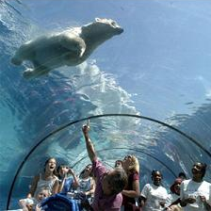
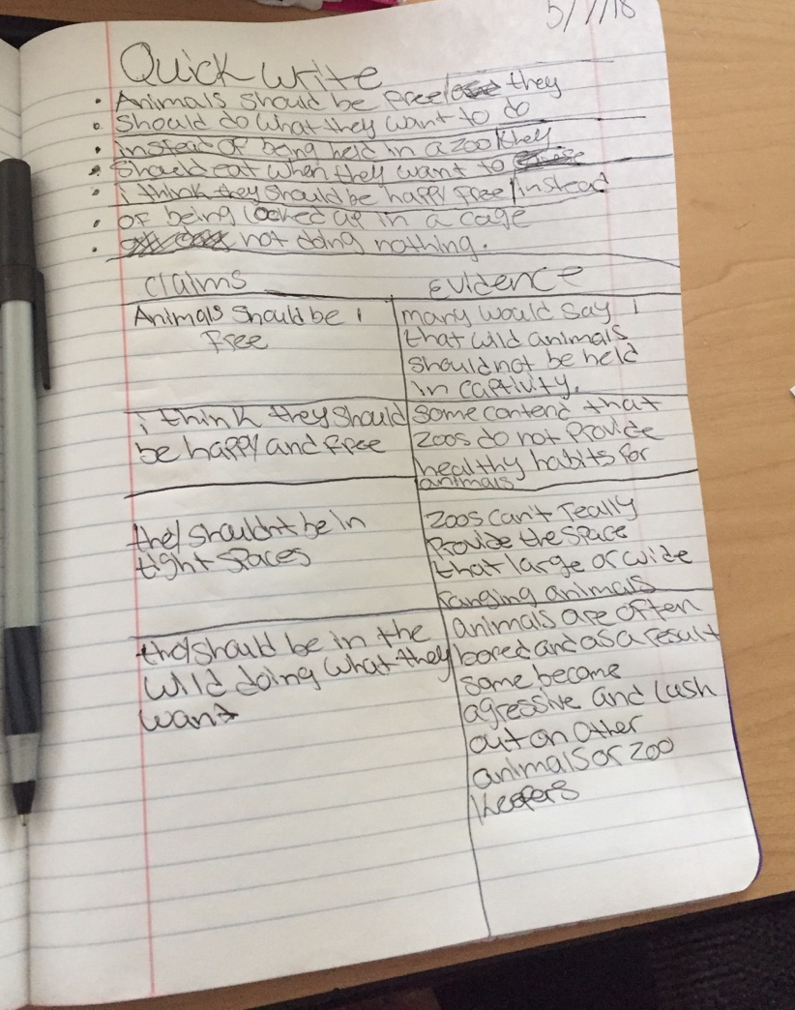
Quick Write
Write for 5 minutes.
Create a list as long as you possibly can!
1. What are some potential claims about the topic of zoos?
2. Look at your annotating and create an Author’s purpose statement (main idea, the gist) in your Writer’s Notebook. Ex. The main idea in this article is…
Connecting Evidence to Claim
Day 2
Connecting Evidence to a Claim was developed by Jean Wolph.

Slide 8
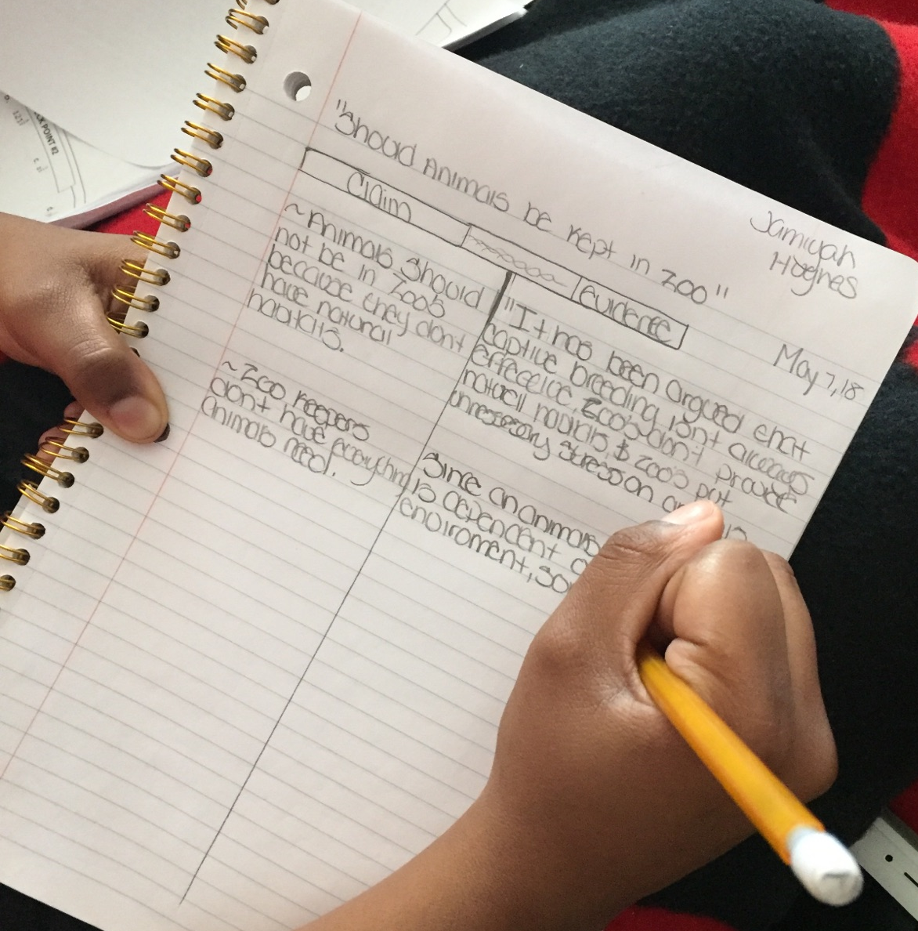
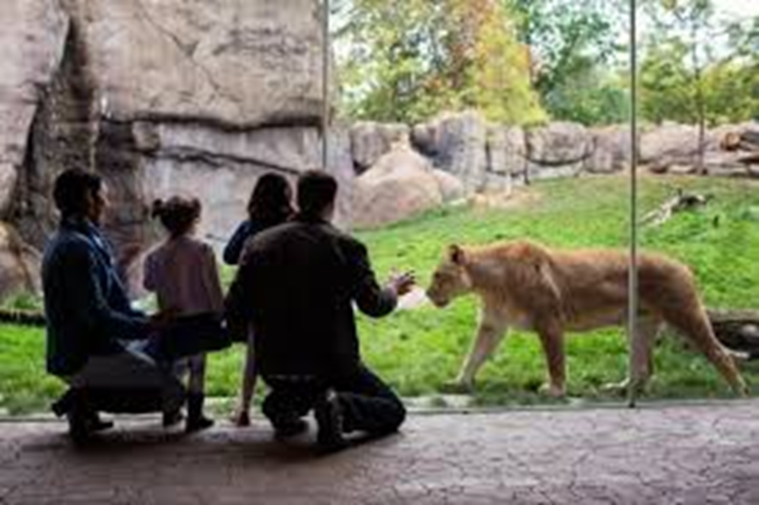
Connecting Evidence to Claim
Day 2
Review by skimming and scanning the article,“Should Animals Be Kept in Zoos”
Create a T-Chart in your Notebook. On one side make a list of the claims you came up with in your Quick Write. On the other, match up evidence from the text that would fit each claim.
Pick your three BEST claims!
Connecting Evidence to a Claim was developed by Jean Wolph.
Notes:
Days 1-3
This mini-unit would be taught AFTER students have had some practice in drafting claims and identifying appropriate evidence to support a claim. These tasks would therefore be done fairly quickly—perhaps in 2-3 class periods, especially if students are able to complete some of the work at home. Strategies learned in other mini-units should be used to annotate the texts and identify potential evidence. Mini-units which might proceed this one include Reality TV and Nutrition & Schools.
This mini-unit could also be inserted WHILE you are teaching a different mini-unit. Start with Slide 4 after students have read and annotated texts for potential evidence to support a claim.

Slide 9
Connecting Evidence to Claim
Day 2
POTENTIAL CLAIMS ABOUT THE TOPIC OF ZOOS
“Should Animals Be Kept in Zoos?”
POTENTIAL CLAIMS:
1.Animals do not belong in zoos because they do not have a natural habitat.
2. Animals do not belong in zoos because zoos don’t have everything they need.
3. Zoos are needed to help those animals that are endangered.
4. Zoos are unhealthy for animals.
5. Zoos are needed to prevent animal extinction.
6. Zoos help to educate people about animals from around the world.
7. Zoos are helpful for animals that are injured or ill so they can be let back into the wild.
8. Zoos are educational and fun for kids.
9. Zoos are places to see animals that you otherwise would not be able to.
10.Zoos make people more compassionate towards animals.

Slide 10

Read: “Do We Need Zoos?”.
Connecting Evidence to Claim
Day 3
Close Reading
As you read the texts, look for
Key words. Circle these important words.
Claims and counterclaims Star or mark in some way sentences that state what the writer is trying to do in the text.
Evidence. Underline important evidence.
Author’s purpose. Write 1-2 sentences at the bottom of the text that state the author’s purpose and/or major claim.
Write Notes in the margins of your texts!

Slide 11
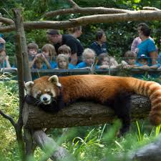
Quick Write
Write for 5 minutes without picking up your pen on this topic:
“Do We Need Zoos?” be sure to support your writing with reasons and evidence
If you do not already have at least 5 possible claims for the topic of zoos, look at the lists charted in your Writer’s Notebook.
Connecting Evidence to Claim
Day 3
Connecting Evidence to a Claim was developed by Jean Wolph.

Slide 12
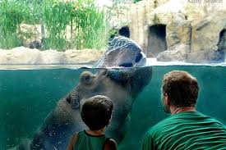
Read:
“Why Zoos Matter”
Connecting Evidence to Claim
Day 4
Close Reading
As you read the texts, look for
Key words. Circle these important words.
Claims and counterclaims Star or mark in some way sentences that state what the writer is trying to do in the text.
Evidence. Underline important evidence.
Author’s purpose. Write 1-2 sentences at the bottom of the text that state the author’s purpose and/or major claim.
Write Notes in the margins of your texts!
Connecting Evidence to a Claim was developed by Jean Wolph.
Notes:
This was a sub assignment in my class this day…can also be done like the previous readings with the teacher in class.

Slide 13

Connecting Evidence to Claim
Day 4
Quick Write
Write for 5 minutes, at least 1 paragraph:
After reading the texts, how do you feel about zoos and animals?
What concerns or questions are sticking out to you?
What societal changes need to happen?
Connecting Evidence to a Claim was developed by Jean Wolph.

Slide 14
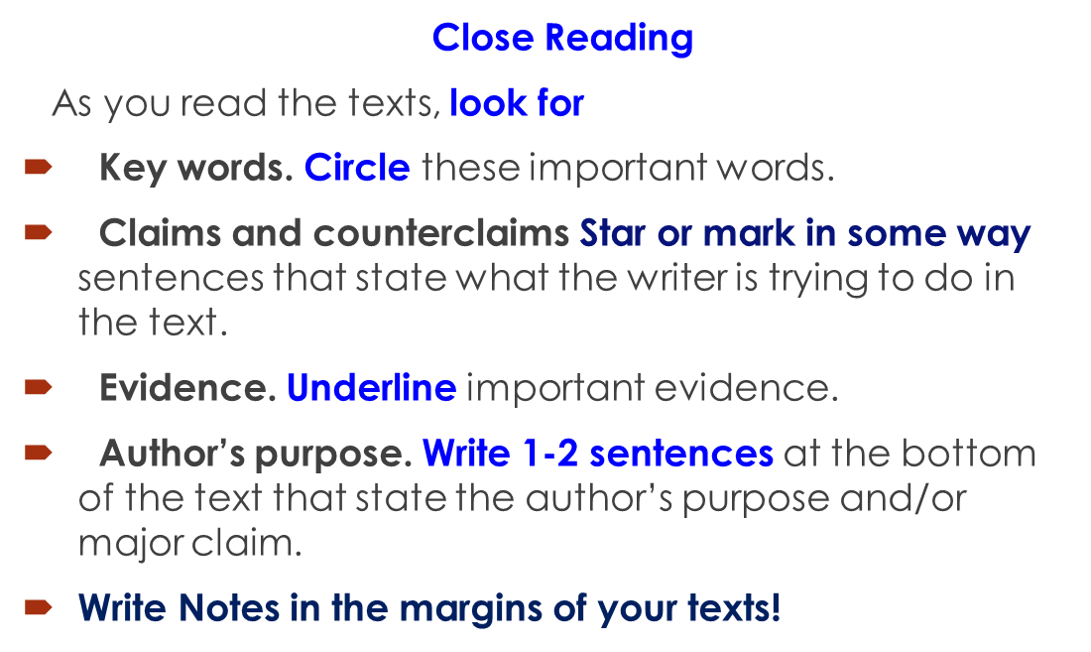
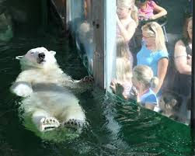
Read:
“A Passionate Call to Leave Animals Alone and Zoos Behind”
Connecting Evidence to Claim
Day 4
Connecting Evidence to a Claim was developed by Jean Wolph.

Slide 15

Connecting Evidence to Claim
Day 5
Answer these questions in your notebook. Yes, write the question.:
1. Should wild animals be kept in zoos?
2. Are all zoos/circuses, etc. created equal?
3. Are there certain minimum standards that all zoos or animal owners should have to meet?
4.Whose job is it to monitor that these expectations are being met?
5. Is our interest in animals or zoos more important than the health of the animals?
6. Are zoos doing enough to educate people about animals and their needs?
7. Is the animal responsible if it escapes or injures a person or is that the fault of the people?
8. Should our society change how zoos operate?

Slide 16
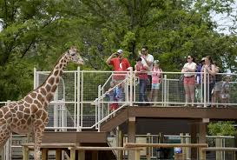
Connecting Evidence to Claim
Day 5
Quick Write
After reading and discussing the articles on the topic of zoos, write down your top three claims on the topic of zoos and zoo animals.
*****Please think specifically about what you would be able to support with the evidence provided.
Connecting Evidence to a Claim was developed by Jean Wolph.

Slide 17
  Illustrating | Using specific examples from the text to support the claim
  Authorizing | Referring to an “expert” to support the claim
  Countering | “Pushing back” against the text in some way (e.g., disagree with it, challenge something it says, or interpret it differently)
Connecting Evidence to Claim
Day 5
In this mini-unit, we’ll practice ways that writers use sources to develop their arguments. These are called argument moves.
Review
Connecting Evidence to a Claim was developed by Jean Wolph.
Notes:
Selected slides in this mini-unit can be revisited as students work on daily argument writing and/or on other mini-units, to remind students what these moves look like in the context of developing an argument.

Slide 18


Connecting Evidence to Claim Day 5
???
What will we do when we are…
???
  Authorizing:
  Referring to an “expert” to support the claim
Connecting Evidence to a Claim was developed by Jean Wolph.

Slide 19


Connecting Evidence to Claim Day 5
  Authorizing is a move in argument writing.
First, we select a compelling piece of evidence.
Then we identify the source of the evidence.
Finally, we show the importance of that source, if it is not obvious.
Connecting Evidence to a Claim was developed by Jean Wolph.

Slide 20
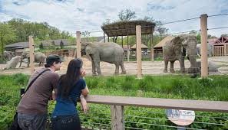
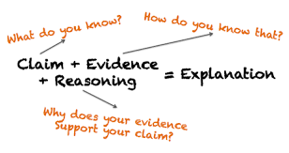
Connecting Evidence to Claim Day 5
  Let’s Practice Authorizing
  Review your text set on Zoos. Select 2-3 pieces of compelling evidence—EVIDENCE THAT WILL SUPPORT YOUR CLAIM—in which the source is clearly identified.
  Think: Is the source reputable? Why? In what ways is this person or agency an “expert”? How can I use this information to support my claim?
Connecting Evidence to a Claim was developed by Jean Wolph.
Notes:
FYI– this sample comes from a different topic – Body Image– We used this different topic in an effort to not influence the students’ claims.

Slide 21
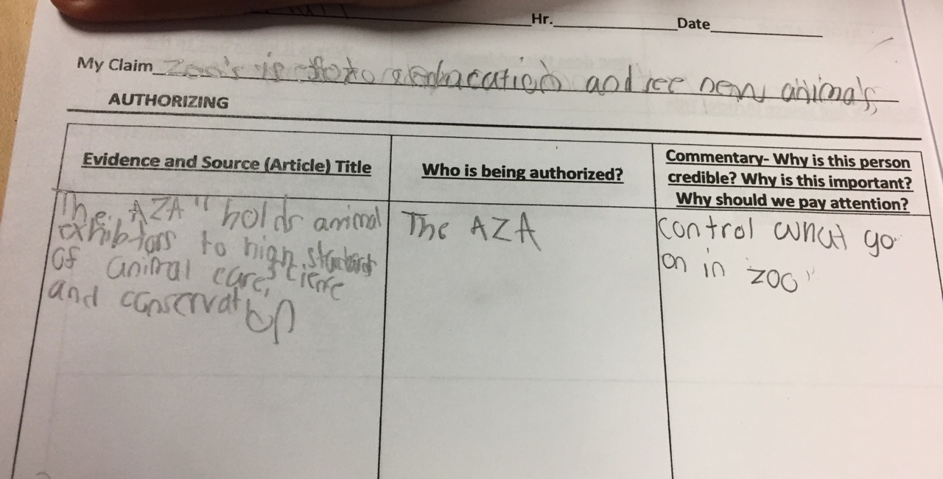
Day 5
Try it: Authorizing with Evidence that
Supports YOUR Claim About Zoos
Connecting Evidence to a Claim was developed by Jean Wolph.

Slide 22
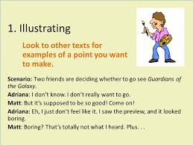
Connecting Evidence to Claim Day 6
What will we do when we are…
???
???
Illustrating:
Using specific examples from the text to support the claim
Connecting Evidence to a Claim was developed by Jean Wolph.

Slide 23
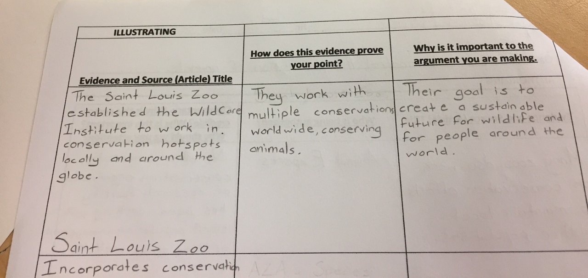
Connecting Evidence to Claim Day 6
Try it: Illustrating with Evidence that
Supports YOUR Claim about Zoos

Slide 24
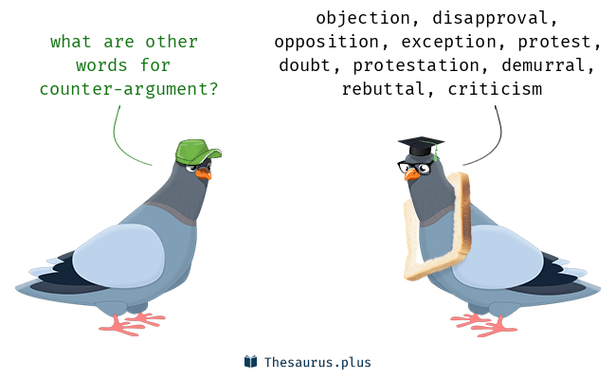
Countering Moves
Connecting Evidence to Claim Day 6
When students “push back” against the text in some way. They might disagree with it, challenge something it says, or interpret it differently than the author does.

Slide 25
Connecting Evidence to Claim Day 7
Try it: Countering the Opposition of Your Claim About Zoos
Countering

Slide 26
Final Writing Task—Put it all together:
Students Will Be Able To Bring All Of The Information Together In An Organization Of Their Choosing To Create The Essay.
Essays Must Include:
A Clear Debatable And Defendable Claim,
2 Pieces Of Illustrating Evidence,
Pieces Of Authorizing Evidence,
And 1 Counter.
Day 8
In order to answer this question…keep in mind that you are trying to persuade your audience to believe the same thing about zoos that you believe!
What organization structure will you use to compose your essay? So, think about what information should come first, what’s next, what’s connected in the same paragraph together, etc.

Slide 27
Day 8
Do Now:
No matter what kind of essay you’re working on, some elements of essay structure stay constant: COPY THESE NOTES BELOW NOW!
1. Introduction paragraph:
-background info
-claim
2. Body paragraph(s):
-topic sentence
-evidence
-commentary
3. Conclusion paragraph:
-restate claim
-answer the question: so what?
*Must be organized into paragraphs
*Length- multi-paragraph
*Clear defendable and debatable claim
*Evidence expectations-
2+ illustrating,
2+ authorizing
1 countering

